Slide 1


Data/Tech Job Portal Pipeline Project
Building a Comprehensive Data Pipeline for Job Market Analysis
Team Leader: Benjamin
Team Member: Marcus, Michelle

Slide 2

Project Overview
This presentation outlines the development of a comprehensive data pipeline for job market analysis.
01
02
03
Project Objectives
Problem Statement
ETL Processes

Slide 3

Project Objectives
Create a pipeline for data loading from job portal/dataset
Script in Python for connection to PostgreSQL DB
Table Creation
Data Transformation
Data Visualization

Slide 4

Problem Statement
We have been tasked to create a source of information for job postings found on the internet for another department's use for analysis
Key Research Questions:
What are the core skills now for a DATA / TECH job?
Top companies offering the highest average salaries?
How do job salaries vary across countries?

Slide 5

Implementation Timeline
This timeline outlines the key phases of the project, from initial data setup to final documentation and presentation.
Phase 1: Data Source Setup
1
(Day 1-2)
Exploration of website & data source method
Understanding API use and setup
2
Phase 2: Database Design & Setup
Kaggle dataset as supplementary data
(Day 3-4)
Schema design
Phase 3: ETL Development
3
Table creation
(Day 5-7)
PostgreSQL configuration
Data extraction
Transformation
4
Phase 4: Analysis & Visualization
Loading
(Day 8-9)
Validation
Data analysis
Phase 5: Documentation & Presentation
5
Visualization generation
(Day 9-10)
Reporting
Presentation Day 15 Dec )
Final documentation
Presentation deck creation

Slide 6


Data Sources
Web APIs
Kaggle Datasets
Limited data from job portals with API access. Was able to find one that worked with an API call, with limited returned data.
Supplementary dataset for comprehensive data engineering practice. We decided to supplement the database with a dataset from Kaggle so that we could also learn/practice more on the data preparation process.

Slide 7
Technology Stack
Database
PostgreSQL
Aiven.io (Online Free DB service)
Version Control & Collab
Github Remote Repo
Github Desktop
Data Sources
Web APIs
Kaggle Dataset
Data Processing
Pandas
Numpy
Database Connectivity
SQLAlchemy
Psycorpg2
Data Extraction
Requests
Time
Resp.json() requests
Database Cleaning
re
html
Data Visualization
Collections (Counter)
Matplotlib
WordCloud

Slide 8
Challenges Faced
1
Tried web crawling for employment postings to find out more about Data Engineering roles. There were restrictions for web crawling on most job portals. Was able to find 2 that worked with an API call, with limited returned data.
2
We decided to supplement the database with a dataset from Kaggle so that we could also learn/practice more on the data preparation process
3
Errors while Coding in python.
Got AI assistance explaining the hurdles we faced to debug the script. Also a learning experience how to do prompting for accurate assistance

Slide 9
Suggested Functionality
Additional Features
Output Options
Table normalizations in in the database
Data tables in Online DB
Visualizations for data collected
Create word cloud based on frequencies of data engineering keyword skills
User query
Automate pipelines using Airflow- (Phase 2)

Slide 10
Data Pipeline Workflow - Coding
Below are the essential steps for transforming raw data into the final schema for analysis:
1. Crawl data from the source. (API / Dataset)
2 Load the data into a DataFrame for further processing.
3. Match country names against the official country list to retrieve the corresponding country codes.
4. Clean the company name column using the standard cleaning function.
5. Insert distinct company names into the dim_companies table.
6. If available, create column and insert value in working DF with referencing country code
7. Populate the DataFrame with the relevant company_id in a new column.
8. Clean other text columns as needed, reusing the same cleaning function applied to company names.
9. Handle additional cleaning requirements via separate dedicated cleaning functions, if necessary.
10 Update the fact_jobs table with the processed and cleaned data.

Slide 11
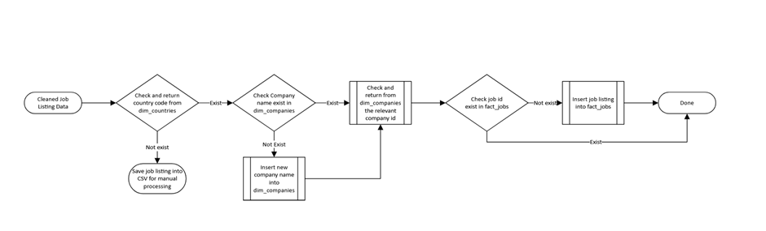

Data entry into database workflow

Slide 12

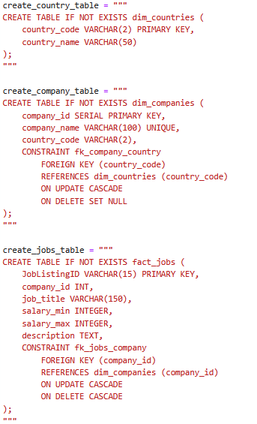
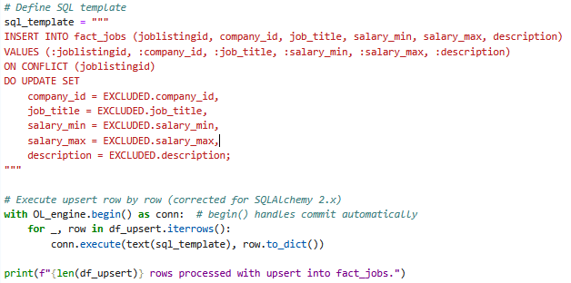
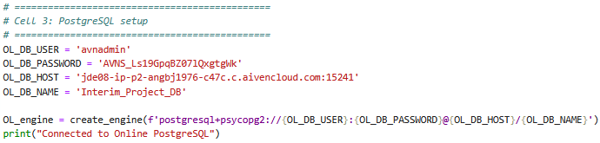
Code Snippets (PostgreSQL DB Process)
Libraries Used
SQLAlchemy (create_engine, text)
psycopg2 (via SQLAlchemy)
Pandas
Key Points of the Code
Database Engine Creation
Builds a connection string using credentials (user, password, host, database).
create_engine(...) sets up a reusable connection interface to PostgreSQL.
Table Creation (DDL)
Three tables defined “dim_countries”, “dim_companies”, “fact_jobs”
Includes foreign key constraints with CASCADE rules to maintain referential integrity.
SQLAlchemy Transaction Block
with OL_engine.begin() as conn: automatically manages commit/rollback.
Ensures safe batch execution of multiple row updates.

Slide 13
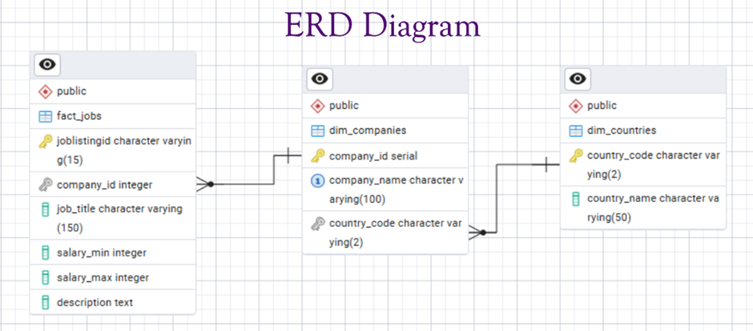
Database Schema Overview
Below is an overview of the core tables designed for the Data Engineering Job Portal pipeline, outlining their primary purpose and key fields.

Slide 14
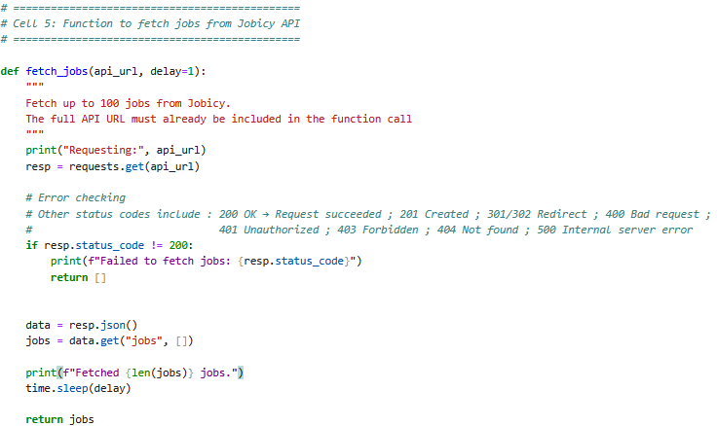
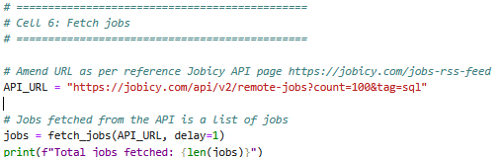
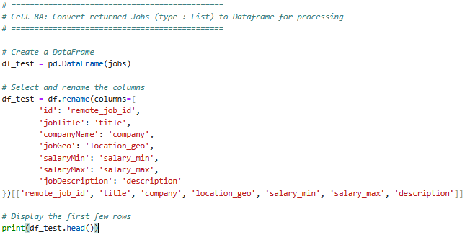
Code Snippets (API call for Data Fetch)
Libraries Used
Requests - Handles response objects and status codes.
Time - Used for adding a delay between API calls to avoid rate-limit issues.
Pandas - Converts the list of job dictionaries into a DataFrame for cleaning and processing.
Resp.json() - Parses the JSON response returned by the API into Python objects.
Key Points of the Code
API Fetching Function (fetch_jobs)
The function accepts a full API URL and an optional delay parameter.
Uses requests.get() to retrieve job data from Jobicy.
Includes HTTP error checking:
Only proceeds if status code is 200 (OK).
For error codes like 400, 401, 403, 404 or 500, it prints the failure and returns an empty list.
Converts the API response to JSON using .json().
Uses time.sleep(delay) to pause between calls to avoid API throttling.
The returned result is a list of job dictionaries, printed for verification.
Transforming API Data Into a DataFrame
Converts the list (jobs) into a pandas DataFrame for easier manipulation.
Renames raw API fields to standardized column names such as:
id → remote_job_id
jobTitle → title
companyName → company
salaryMin/salaryMax → salary_min/salary_max
Selects only the required columns in a consistent order.
Prints the first few rows to verify that data extraction and transformation were successful.

Slide 15
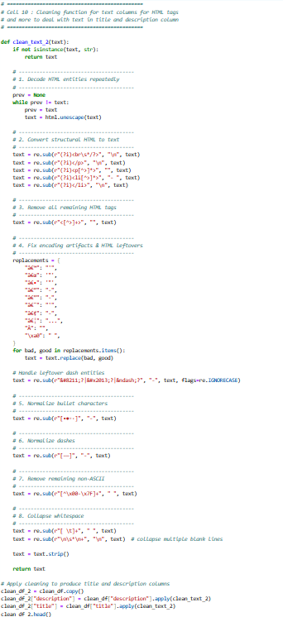
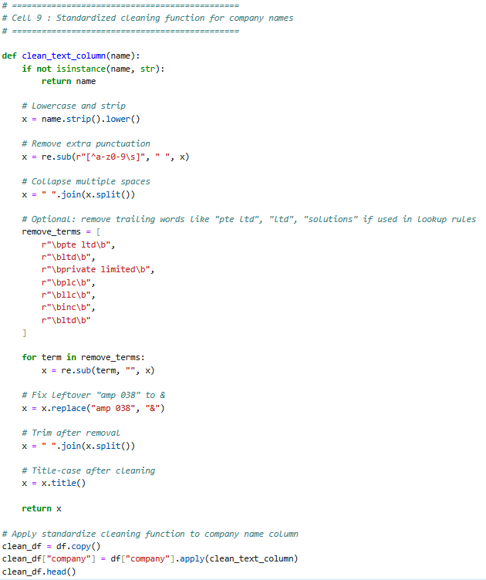
Code Snippets (Data Cleaning)
Libraries Used
re – regex for removing punctuation, HTML tags, and fixing spacing.
html.unescape – decodes HTML entities
pandas – applies cleaning functions across DataFrame columns.
String normalization – standardizes case, spacing, bullets, and dashes.
Key Points of the Code
Company Name Cleaning (clean_text_column)
Lowercases, strips spaces, removes punctuation.
Collapses multiple spaces → single space.
Removes common company suffixes (e.g., ltd, pte ltd, llc, inc).
Fixes encoding artifacts such as "amp 038" → "&".
Converts final output to Title Case for consistency.
HTML Tags Cleaning
Repeatedly decodes HTML entities (e.g., &amp;amp;).
Converts HTML structure into text:
<br> → newline
<li> → "- "
</p> → newline
Removes remaining HTML tags with regex.
Fixes common mis-encoded characters (â€™, â€“, â€¦).
Normalizes bullet symbols and dash variations to a standard form.
Removes non-ASCII characters for database safety.
Cleans up whitespace and extra blank lines before returning final text.

Slide 16




Key Analysis Questions
Which companies offer the highest
average salaries?
What are the core skills now for a DATA/TECH
job?
Which country are most DATA/TECH jobs coming from?

Slide 17
Disclaimer :
The findings presented in this report do not represent
a comprehensive view of job postings globally.
The current data retrieved via the API reflects only the specific parameters used and can be expanded for broader coverage.
Additionally, a significant portion of the data is sourced from a specific Kaggle dataset.

Slide 18
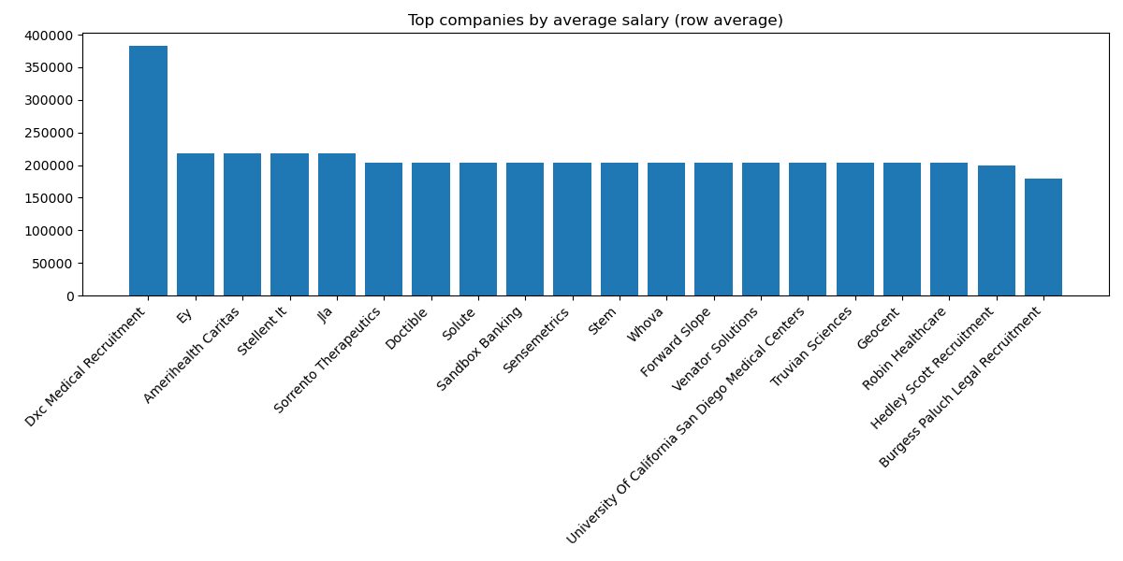
Key Question : Which companies offer the highest average salaries?

Slide 19
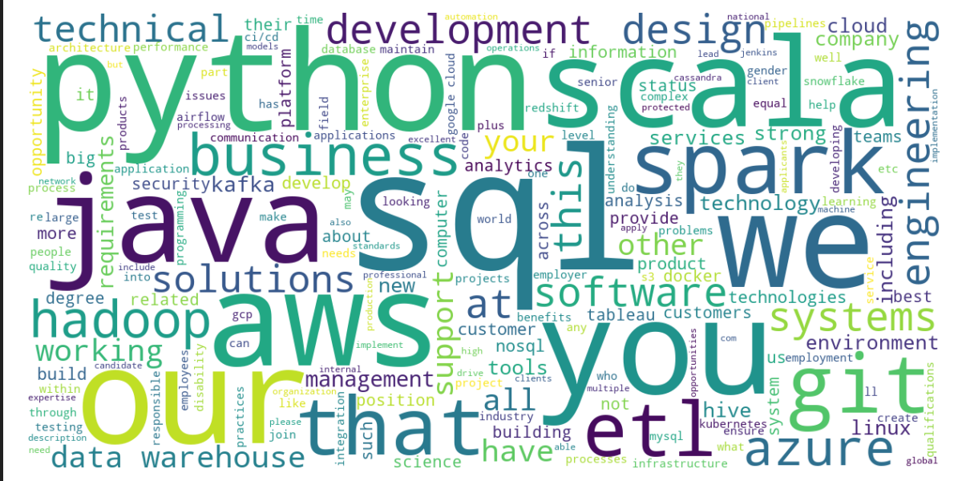
Key Question : What are the core skills now for a DATA Engineer job?

Slide 20
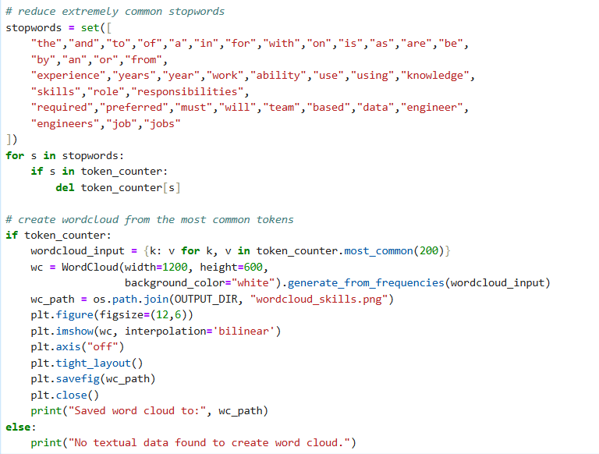
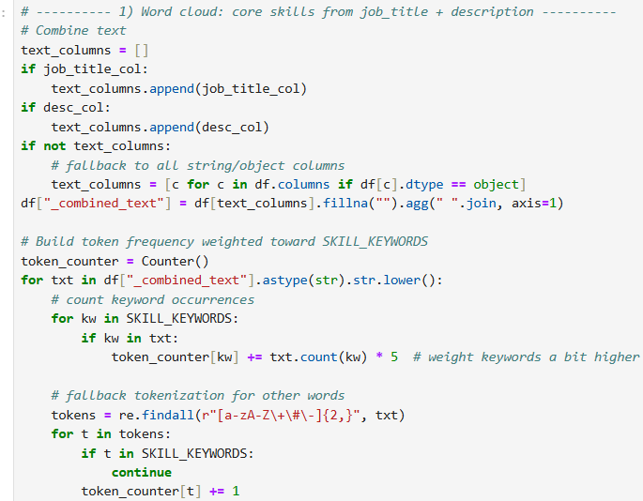
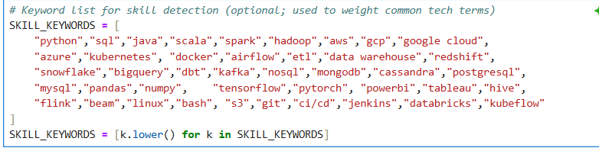
Code Snippets (Word Cloud)
Combine text columns: Merge job title and description into one.
Count keywords: Weight skill keywords higher in frequency count.
Tokenize text: Extract other words using regular expressions.
Remove stopwords: Delete common, non-informative words from counts.
Generate word cloud: Visualize top 200 tokens and save image

Slide 21
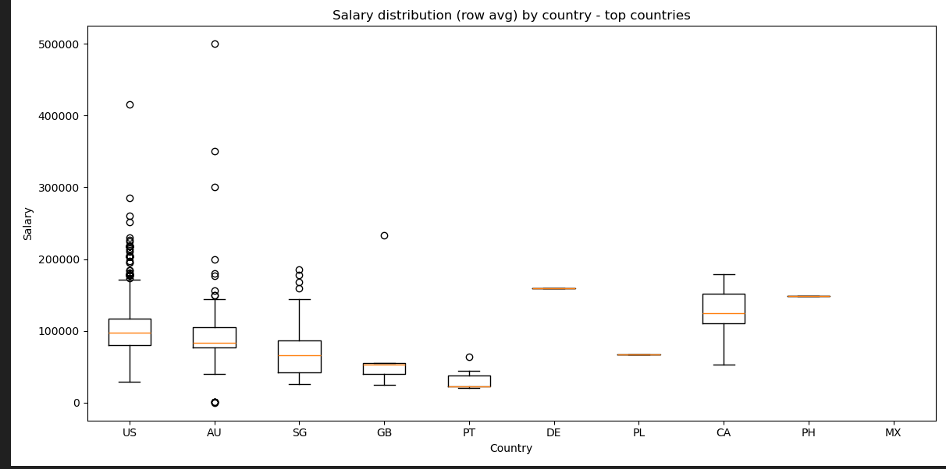
Key Question : How do job salaries vary across countries with Min & Max?

Slide 22
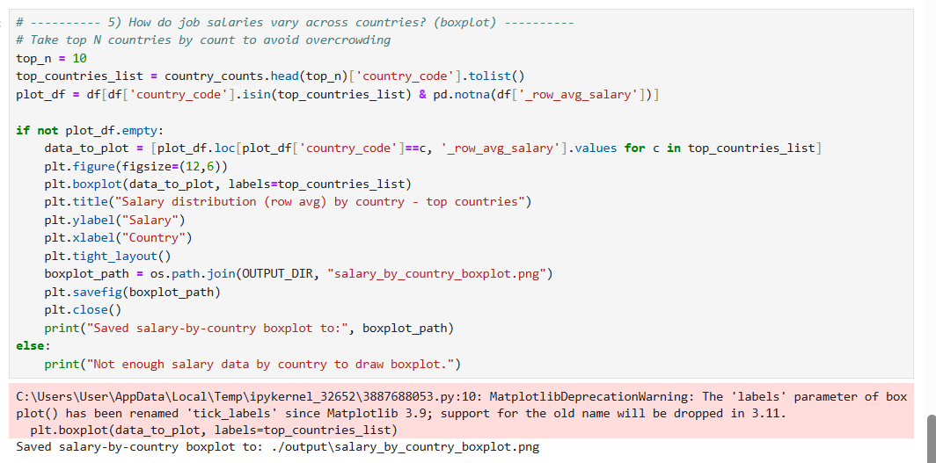
Code Snippets (Visualization)
Select top countries and filter rows with valid average salary.
Group salary values by country for boxplot visualization.
Generate and save boxplot showing salary distribution differences.

Slide 23
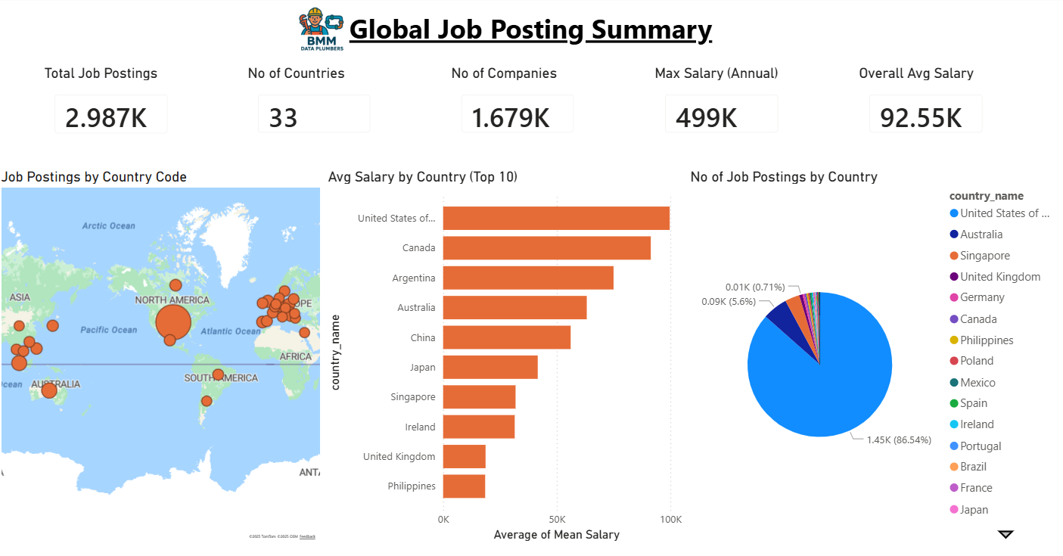
Future Considerations
Enhance data-quality checks to better assess completeness, consistency, and potential biases.
Load cleaned data into additional analytics/BI tools (e.g., Power BI, Tableau) for deeper exploration and visualization.
Implement automated, scheduled data ingestion using orchestration tools such as Apache Airflow.
Expand data sources and enrich datasets, integrating more job APIs or complementary datasets for broader insights.
Add monitoring, logging, and validation to detect API issues, track pipeline performance, and maintain long-term data reliability.

Slide 24
Key Learnings & Takeaways
Data Quality Matters
API Limitations
Importance of data validation and cleaning in ETL processes
Understanding constraints of third-party APIs and need for alternative data sources
Database Design
Agile Approach
Proper schema design with dimension and fact tables for scalability
Ability to pivot and adapt when initial approach doesn't work
Documentation
Team Collaboration
Document thoroughly and comment scripts to ensure project sustainability and easy follow-up.
Effective teamwork and knowledge sharing across different skill sets

Slide 25
Thank You
Presented by: Ben, Marcus, Michelle
Questions & Answers

